Slide 1
HandsMen Threads: Elevating the Art of Sophistication in Men's Fashion

Slide 2
ABSTRACT
The HandsMen Threads project implemented a customized Salesforce CRM for a premium men’s fashion brand to improve workflows, customer engagement, and data accuracy. It used custom objects, automation tools (Flows, Email Alerts, Apex), validation rules, and role-based access to manage customers, orders, inventory, and marketing. The system boosts operational efficiency, personalizes customer communication, and provides a scalable platform for future growth.

Slide 3
OBJECTIVE
The core aim of this project was to create and implement a bespoke Salesforce CRM for HandsMen Threads to improve key business processes, protect data integrity, and enhance customer satisfaction.
By centralizing customer, order, product, inventory, and marketing data, the project sought to:
Automate essential workflows like order confirmations, loyalty status updates, and inventory alerts.
Maintain consistent and accurate data through validation mechanisms.
Provide real-time insights into inventory levels and customer activity.
Strengthen team collaboration with role-based access restrictions.
Deliver customized customer experiences via targeted marketing and loyalty initiatives.

Slide 4
TECHNOLOGY DESCRIPTION
Salesforce Salesforce is a cloud-based Customer Relationship Management (CRM) platform that helps businesses manage customer data, automate processes, and improve service, marketing, and sales operations. It provides point-and-click tools as well as programmatic capabilities (like Apex and Flows) to build custom business solutions.
Custom Objects
Objects in Salesforce are like tables in a database. Custom Objects are created to store specific data.
Customer__c – Stores customer info
Product__c – Stores product details
Order__c – Stores orders

Slide 5
Tabs make it easy to access and display object records in the Salesforce interface.
Example: A Product__c tab allows quick management of product records.
Custom App
A packaged group of tabs and features designed for a particular business function in Salesforce.
Profiles
Define what each user can view, edit, or delete in the system, controlling field-level and object- level access.
Roles
Organize data visibility according to the company’s hierarchy, enabling sharing and reporting capabilities.

Slide 6
Permission Sets
Grant extra permissions without changing a user’s primary profile.
Validation Rules
Business logic that ensures the data entered follows company guidelines.
Example:
Email must include @gmail.com
Stock value cannot be less than zero
Email Templates
Reusable message formats for communication with customers.
Example: “Order Confirmation” template

Slide 7
Email Alerts
Automatic email notifications triggered by system changes.
Example: A loyalty tier update sends an email to the customer.
Flows
Point-and-click automation tools to handle processes without coding.
Example: Automatically send an email alert when a new order is placed.

Slide 8
Apex
Salesforce’s coding language for building complex custom functions.
Example use cases:
Update Total_Amount__c in order records
Adjust stock quantities in inventory

Slide 9
PROJECT EXECUTION STEPS
1. Developer Environment Setup
Registered a Salesforce Developer Org via developer.salesforce.com/signup.
Verified credentials, set a secure password, and logged into the Setup area.

Slide 10
2. Custom Object Development
Five key custom objects were built to capture business-critical data:
HandsMen Customer – Client contact and loyalty program details.
HandsMen Product – Product catalog information like SKU, pricing, and availability.
HandsMen Order – Purchase details, quantities, and order status.
Inventory – Warehouse stock levels and locations.
Marketing Campaign – Campaign details, schedules, and promotions.
Process:
Navigated to Setup → Object Manager → Create → Custom Object.
Defined labels, names, and enabled search/report options.
Created tabs for each object.

Slide 11
3. Lightning App Creation
Built a custom Lightning App titled HandsMen Threads CRM.
Included tabs: Customer, Order, Product, Inventory, Campaign, Reports, and more.
Linked to the System Administrator profile.
4. Data Validation Rules
Examples applied:
Order Object – Blocks save if Total_Amount__c <= 0.
Error: “Please enter a valid amount.”
Customer Object – Requires email to include @gmail.com.
Error: “Enter a valid Gmail address.”

Slide 12
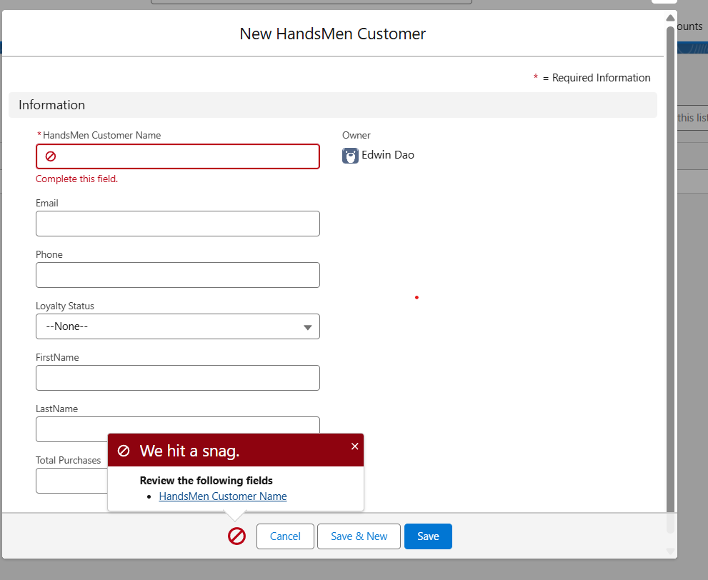
5. Role & Profile Configuration
Created a new profile “Platform 1” cloned from the Standard User profile with added object access.
Established roles for:
Sales Manager
Inventory Supervisor
Marketing Coordinator

Slide 13
PROJECT EXPLANATION WITH REAL-WORLD EXAMPLE
1. Customer Registration
A customer, Daniel Carter, visits the boutique or online store.
In Salesforce: A new record is created in the Customer object with his name, phone, email, and loyalty status.
Validation Rule: Ensures the email format is valid (e.g., must contain @yahoo.com).
2. Product Setup
The admin adds products like Blazers, Trousers, and Accessories into the Product__c object.
Each product includes a price, SKU, and description.
Inventory records are created to track stock levels for these products.

Slide 14
3. Order Placement
Daniel purchases 1 Blazer priced at ₹3000 and 1 Tie priced at ₹500.
In Salesforce: A new Order record is created.
Apex Trigger: Automatically calculates Total_Amount__c = 1 × 3000 + 1 × 500 = ₹3500.
4. Inventory Update
Once the order is confirmed:
Apex Trigger on Inventory reduces Blazer stock by 1 and Tie stock by 1.
Validation Rule: Prevents stock levels from dropping below zero.
5. Loyalty Program
Daniel’s total purchase amount is now ₹3500.
A trigger on Customer evaluates total spending.
Based on the value:
< ₹2000 → Bronze
₹2000 – ₹5000 → Silver
₹5000 → Gold
Daniel becomes a Silver member.

Slide 15
6. Email Notifications
When a new order is placed or loyalty status changes:
Flow + Email Alert is triggered.
Daniel receives:
“Thank you for shopping with us! Your loyalty status has been upgraded to Silver.”
7. Users and Roles
Salesforce user accounts are set up for store staff:
Sophie Miller – Sales Role (Platform 2 Profile)
Ryan Kapoor – Inventory Role (Platform 2 Profile)

Slide 16
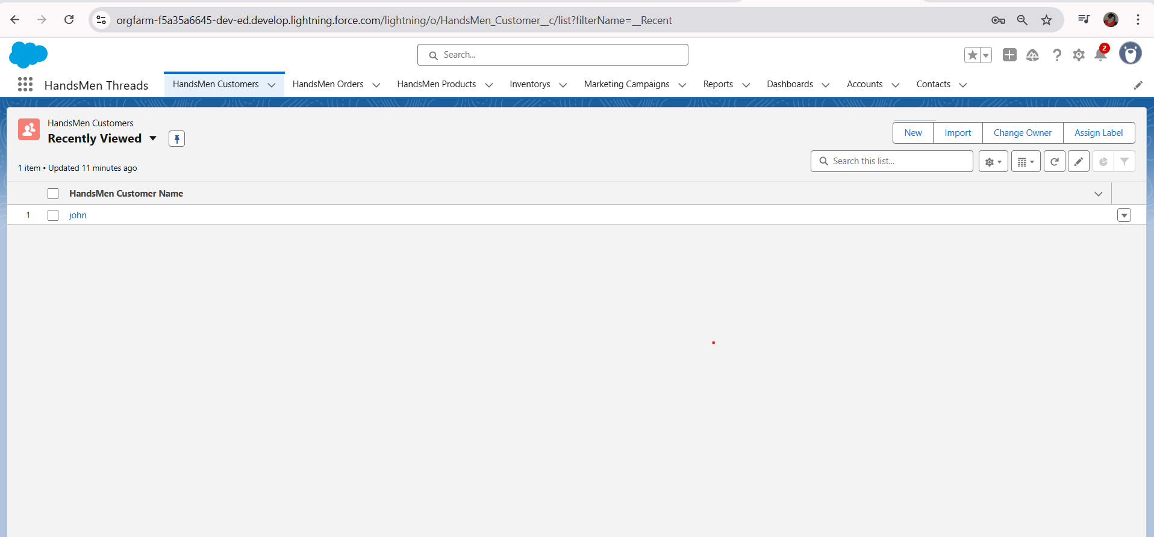
ScreenShots
Fig: Custom App For HandsMen Threads

Slide 17
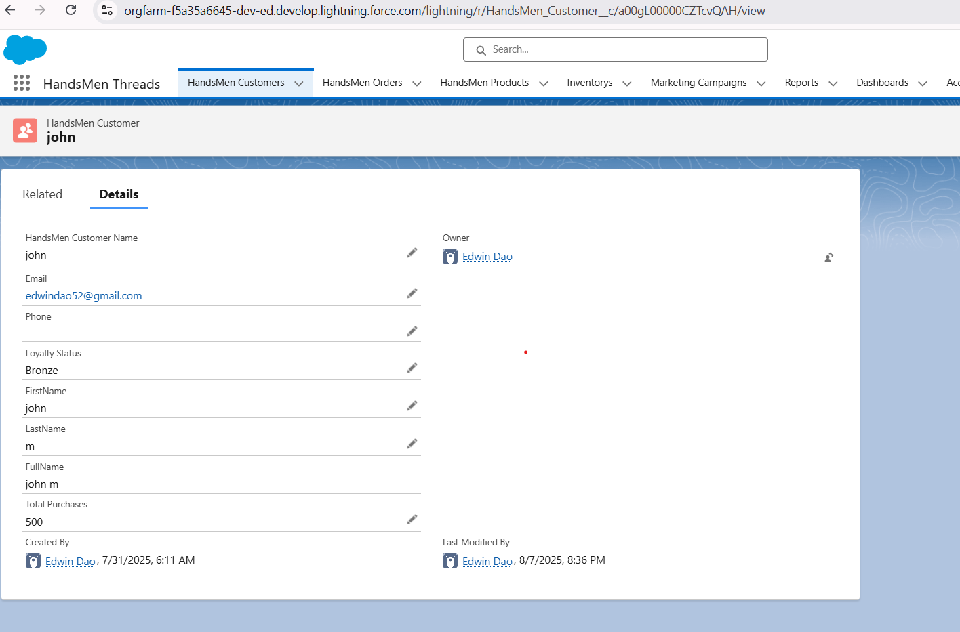
Fig: Customer Creation in HandsMen Threads

Slide 18
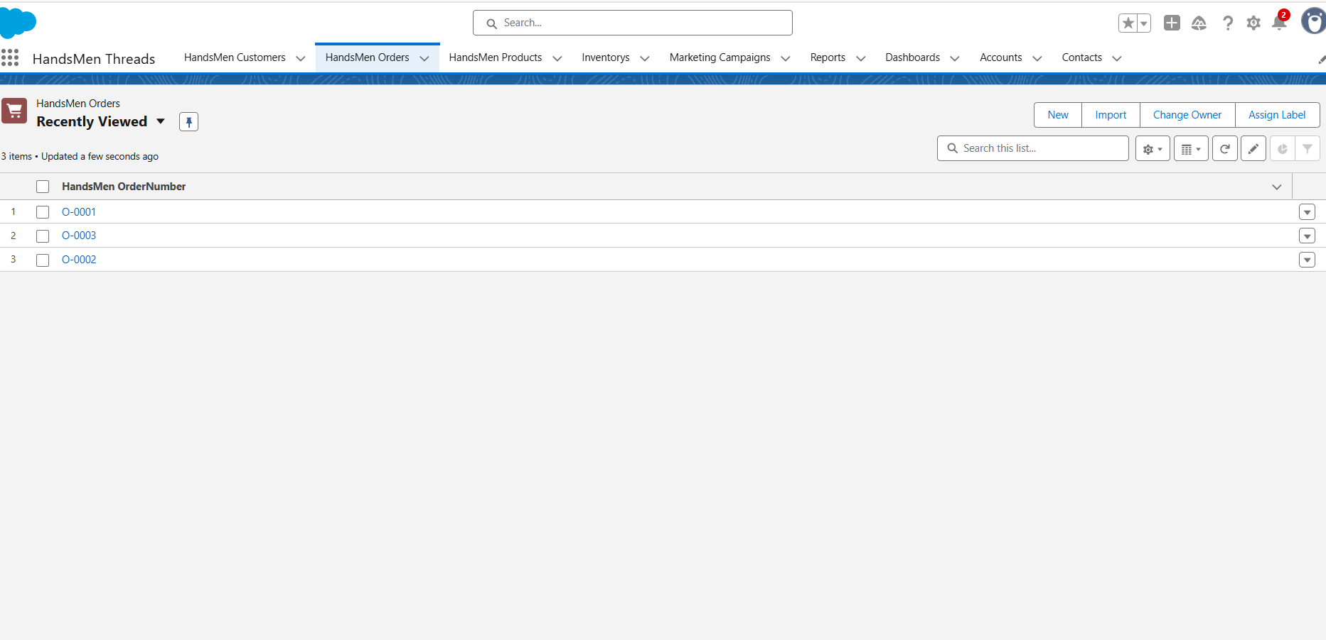
Fig: Order in HandsMen Threads

Slide 19
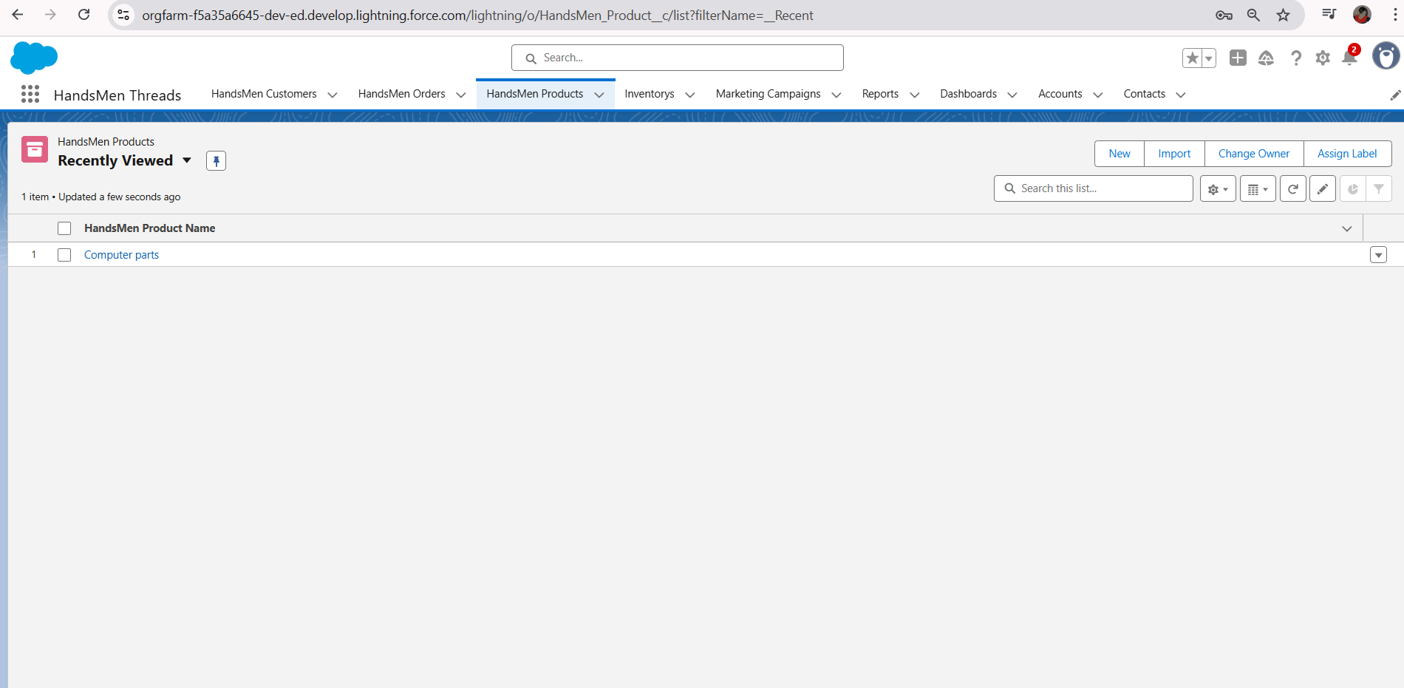
Fig: Products in HandsMen Threads

Slide 20
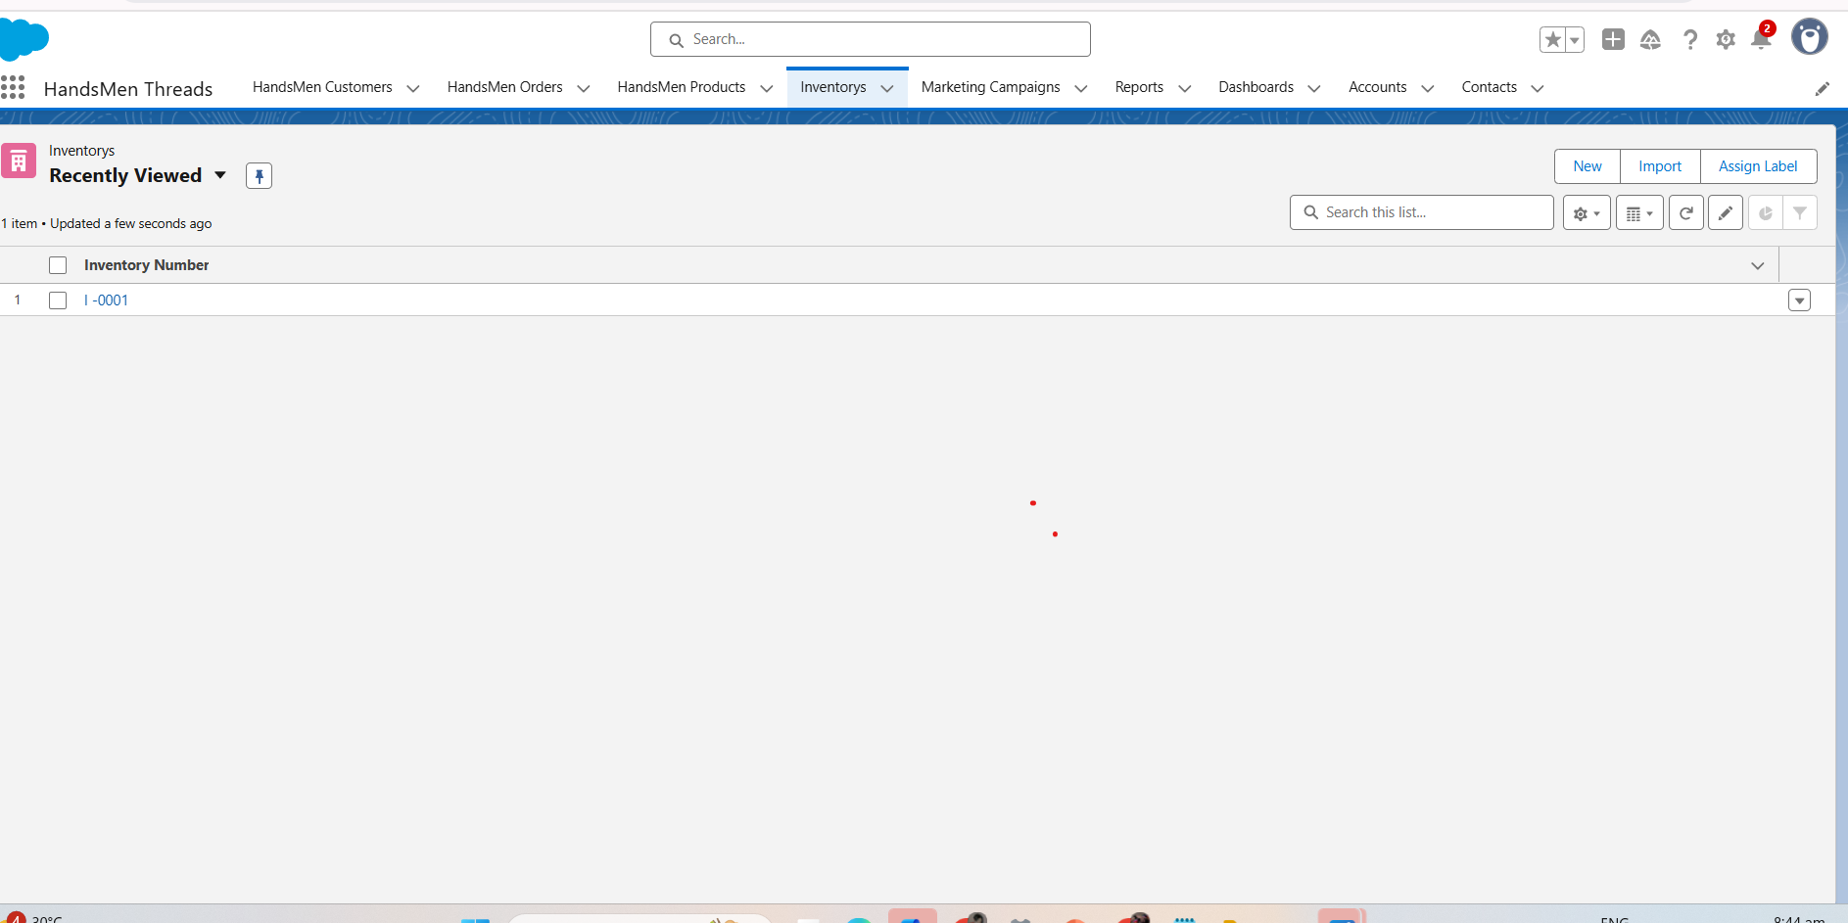
Fig: Inventorys in HandsMen Threads

Slide 21
CONCLUSION
The HandsMen Threads CRM platform, developed on Salesforce, effectively optimizes essential business operations such as customer relationship management, product cataloging, order fulfillment, inventory control, and loyalty program automation. By utilizing Salesforce features like Custom Objects, Flows, Validation Rules, Email Alerts, and Apex, the system delivers reliable data accuracy, real-time updates, and an improved customer journey. The structured automation and well-defined user permissions reduce manual workload, speed up workflows, and provide valuable insights into sales performance and stock levels.

Slide 22
Future Scope:
Customer Portal Integration
Develop a dedicated Customer Community Portal enabling customers to log in, review orders, and track their loyalty program progress.
Mobile App using Salesforce Mobile SDK
Create a mobile application to help store staff manage inventory, orders, and customer data while on the move.
Reports & Dashboard
Design dynamic sales and inventory dashboards for managers to track performance and trends in real time.
AI-Powered Recommendations (Einstein)
Leverage Salesforce Einstein to deliver tailored product suggestions based on customer purchase history.
WhatsApp/SMS Integration
Implement WhatsApp or SMS alerts to keep customers updated on order statuses and loyalty points.

Slide 23
Thank you, Ma’am and Sir!

